Slide 1
Techniques To Implement Web Crawlers Using Multi-Threading
Team: Tri-threads
Divya Mahajan | Shruthi Ramprasad | Xi Liu

Slide 2
Objectives
Introduction
Locking Techniques ( Optimistic, Pessimistic, Coarse-grained, Fine-grained )
Implementation of Lock-free Crawlers
Implementation of Locks using Semaphore mutex
Implementation of locks using Monitors
Demo of the techniques to implement web crawlers using multi-threading
Experimental results and Analysis
Conclusion
Questions???
References
COEN- 283 Operating Systems

Slide 3
What is a multi-threaded web crawler? Introduction to lock-free mechanism

Slide 4





Web Crawlers
COEN- 283 Operating Systems

Slide 5
Parallel Web Crawlers
COEN- 283 Operating Systems

Slide 6















The architecture of parallel web crawlers
Shared Buffer of fixed length
Multi-Threaded Downloader
Visited Links
Currently visited link
URL Frontier List
Crawler
Seed URLs
Thread 1
Crawler Thread 2
Crawler Thread n
Data from crawled links
 | Raw fetched data storage
HTTP
Request
HTTP
Response
Read the file and extract valid links
www
Parser/Filter
Meta Data files
No
Extracted links already visited?
Extracted Links
COEN- 283 Operating Systems

Slide 7
Locking Mechanisms Every locking mechanism is either optimistic or pessimistic

Slide 8
Optimistic vs Pessimistic Approach
Optimistic locking | Pessimistic Locking
No interfering or conflicts No synchronization If conflict is detected, abort transaction, else commit transaction | Record locking prevent simultaneous access to the shared data protect the concurrent update on the shared data
COEN- 283 Operating Systems

Slide 9

Coarse-grained Locking
Head
Thread 1
Coarse-grained multithreaded synchronization insertion of URL in web crawler frontier
COEN- 283 Operating Systems

Slide 10
Coarse-grained Locking
Head
Head
Thread 1
Coarse-grained multithreaded synchronization insertion of URL in web crawler frontier
COEN- 283 Operating Systems

Slide 11
Coarse-grained Locking
Head
Thread 1
Thread 2
Coarse-grained multithreaded synchronization insertion of URL in web crawler frontier
COEN- 283 Operating Systems

Slide 12
Coarse-grained Locking
Head
Head
Thread 1
Thread 2
Coarse-grained multithreaded synchronization insertion of URL in web crawler frontier
COEN- 283 Operating Systems

Slide 13
Coarse-grained Locking
Head
Thread 1
Thread 2
Thread 3
Coarse-grained multithreaded synchronization insertion of URL in web crawler frontier
COEN- 283 Operating Systems

Slide 14
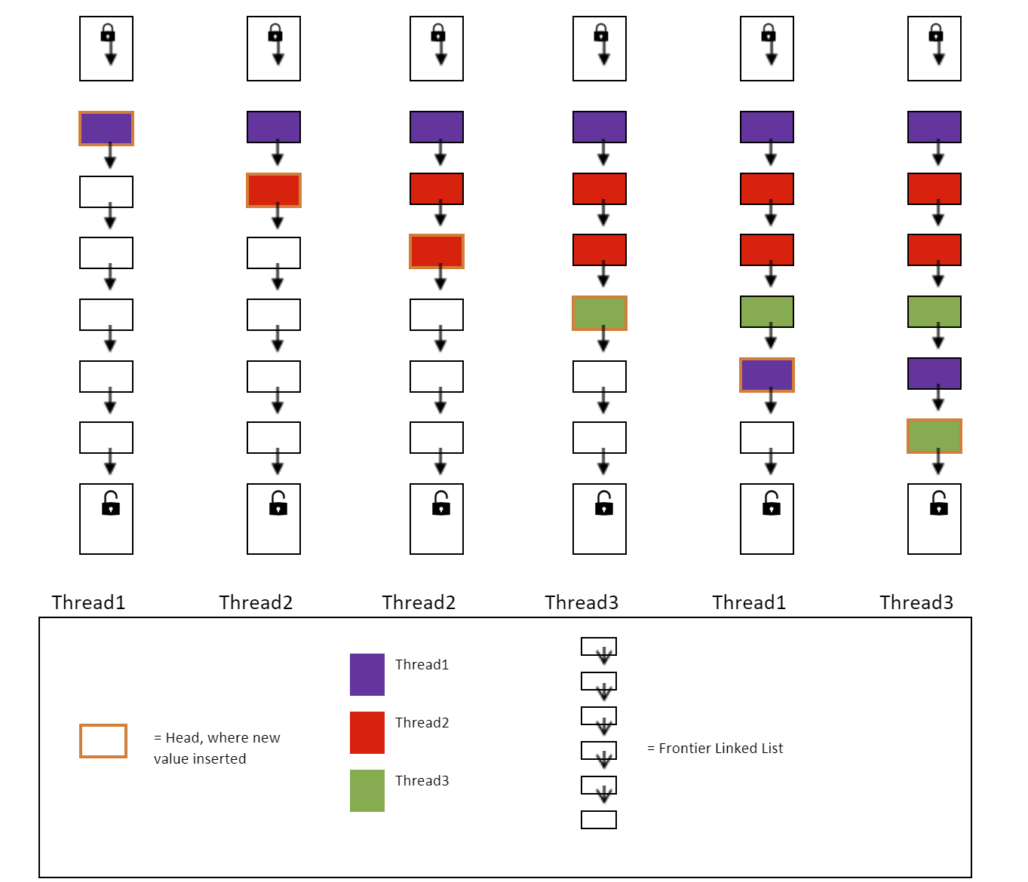
Coarse-grained multithreaded synchronization insertion of URL in web crawler frontier
This list itself has a single lock which every procedure must acquire before the call.
This makes sure that all the actions performed on the list are by holding the lock.
This ensures sequential execution.
COEN- 283 Operating Systems

Slide 15
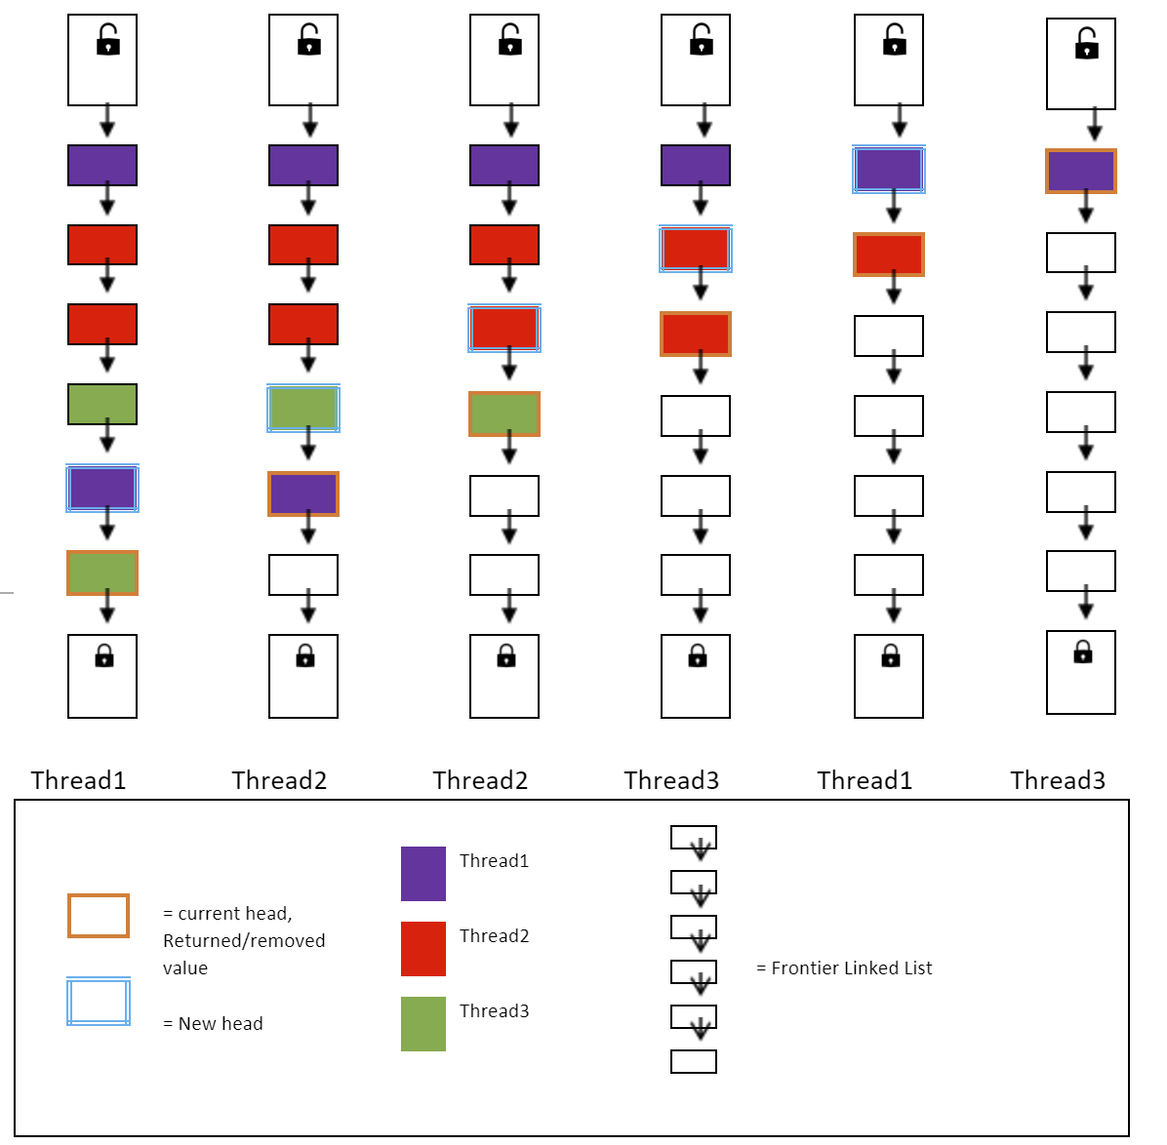
Coarse-grained multithreaded synchronization removal of URL in web crawler frontier
This list itself has a single lock which every procedure must acquire before the call.
This makes sure that all the actions performed on the list are by holding the lock.
This ensures sequential execution.
COEN- 283 Operating Systems

Slide 16
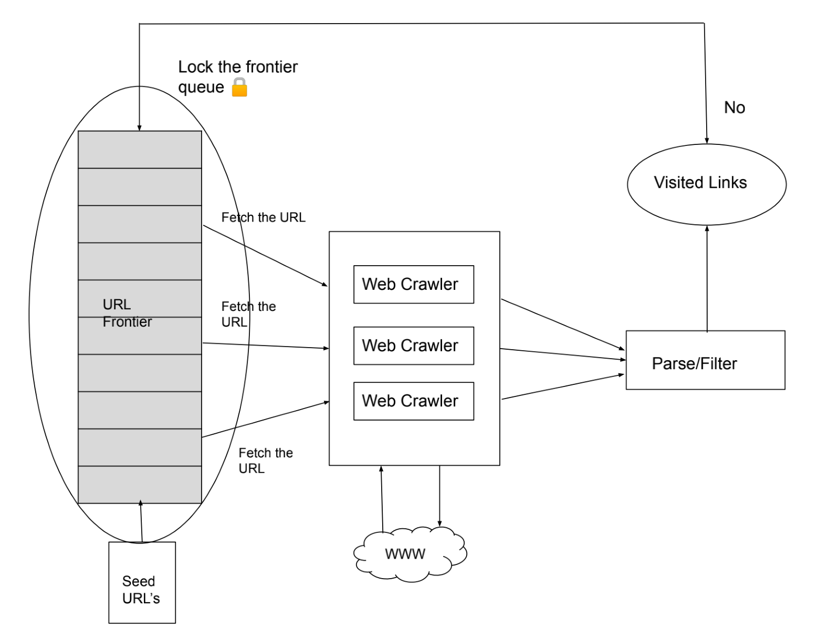
Coarse-grained multithreaded synchronization
COEN- 283 Operating Systems

Slide 17
Fine-grained Locking
Head
Thread 1
Fine-grained multithreaded synchronization insertion of URL in web crawler frontier
COEN- 283 Operating Systems

Slide 18
Fine-grained Locking
Head
Head
Thread 1
Fine-grained multithreaded synchronization insertion of URL in web crawler frontier
COEN- 283 Operating Systems

Slide 19

Fine-grained Locking
Head
Head
Thread 1
Thread 2
Fine-grained multithreaded synchronization insertion of URL in web crawler frontier
COEN- 283 Operating Systems

Slide 20
Fine-grained Locking
Head
Thread 1
Thread 2
Fine-grained multithreaded synchronization insertion of URL in web crawler frontier
COEN- 283 Operating Systems

Slide 21
Fine-grained Locking
Thread 1
Thread 2
Thread 3
Fine-grained multithreaded synchronization insertion of URL in web crawler frontier
COEN- 283 Operating Systems

Slide 22
Fine-grained Locking
Thread 1
Thread 2
Thread 3
Fine-grained multithreaded synchronization insertion of URL in web crawler frontier
COEN- 283 Operating Systems

Slide 23
Fine-grained Locking
Thread 1
Thread 2
Thread 3
Fine-grained multithreaded synchronization insertion of URL in web crawler frontier
COEN- 283 Operating Systems

Slide 24
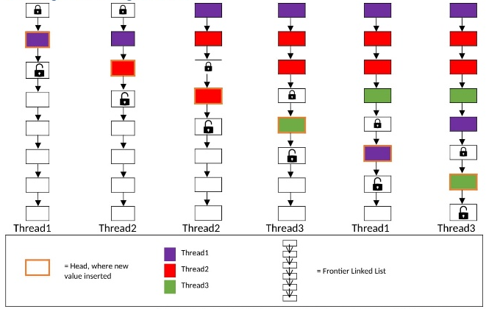
Fine-grained multithreaded synchronization insertion of URL in web crawler frontier
The fine-grained locking approach locks a minimal subset of the data structure. This helps to achieve greater concurrency and often better performance. Rather than protecting all system resources, each fine-grained lock will protect a single resource or a small subset of them.
COEN- 283 Operating Systems

Slide 25
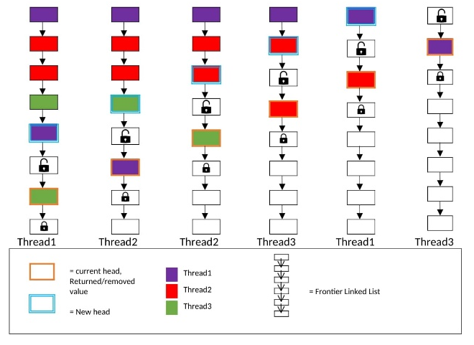
Fine-grained multithreaded synchronization insertion of URL in web crawler frontier
The fine-grained locking approach locks a minimal subset of the data structure. This helps to achieve greater concurrency and often better performance. Rather than protecting all system resources, each fine-grained lock will protect a single resource or a small subset of them.
COEN- 283 Operating Systems

Slide 26
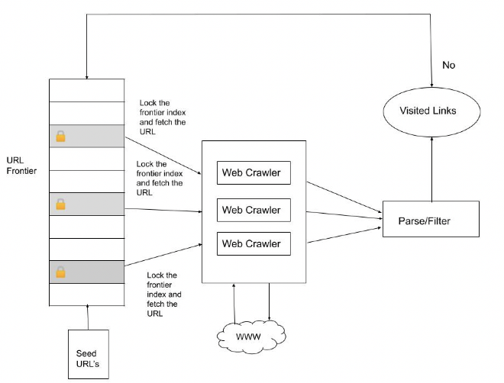
Fine-grained multithreaded synchronization
COEN- 283 Operating Systems

Slide 27
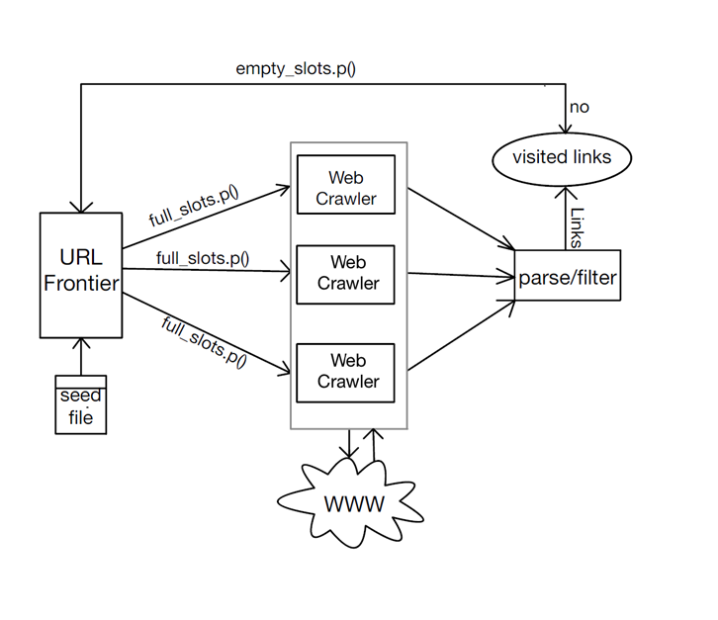
Implementation of Locks using Semaphore mutex
COEN- 283 Operating Systems

Slide 28
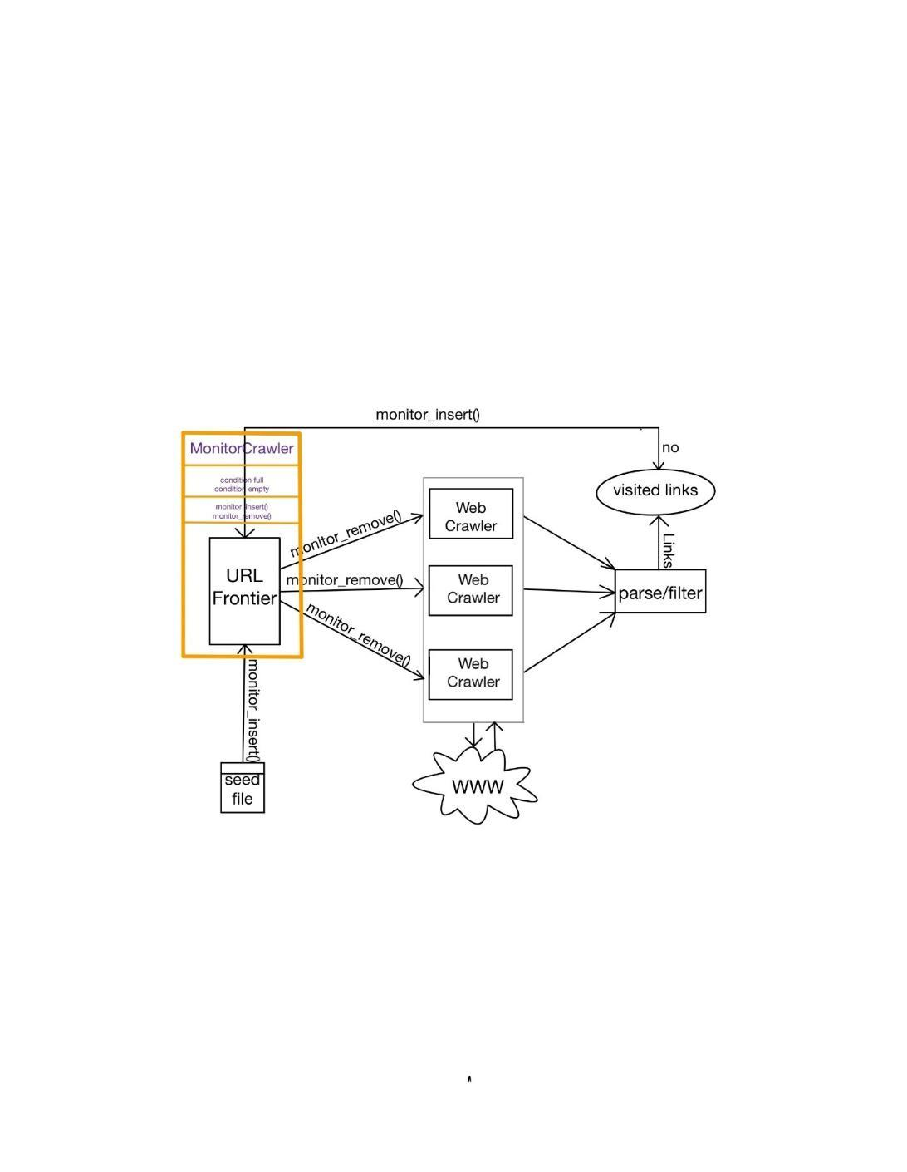
Implementation of Locks using Monitor synchronization
COEN- 283 Operating Systems

Slide 29
Experimental Study Working Demo

Slide 30

Pseudocode:
//Initialization FRONTIER_SIZE=10,20,30 MAX_RUNNING_TIME_SECONDS = 3
Take input of the seed URL from the user file
Validate URL
If the given URL is valid, push the URL into the Seed URL list, else exit
Input the number of threads required to crawl the given URL’s
Input the type of lock the user would wish to implement (Lock-free, Semaphore, or Monitors)
Add the URL from the seed list to the frontier queue via a method add_url_to_frontier
Fetch the URL from the frontier queue via a method get_url_from_frontier
Check whether this URL is already visited or not, if not, push this URL into the visited links list
Crawl this URL
Parse the raw data and extract meta data and links from the crawled URL
Check the new links with the visited links list, if unvisited, add them to the frontier queue via a method add_url_to_frontier
lock-free: frontier_queue.push ()
semaphore: semaphore.insertURL()
monitor: monitor.insertURL()
lock-free: frontier_queue.pop ()
semaphore: semaphore.removeURL()
monitor: monitor.removeURL()
COEN- 283 Operating Systems

Slide 31
semaphore empty_slots = FrontierSize, semaphore full_slots=0, semaphore mutex=1; function insertURL(url){ empty_slots.p( ) mutex.p( ) insert_url_to_frontier(url) mutex.v( ) full_slots.v( ) } function removeURL{ full_slots.p( ) mutex.p( ) url = remove_url_from_frontier mutex.v( ) empty_slots.v( ) }
Pseudocode for Semaphore
COEN- 283 Operating Systems

Slide 32
condition full, empty integer count = 0 function insert(url): { acquire lock while count = FrontierSize {then wait(full)} insert_url_to_frontier(url) count = count + 1 signal(empty) release lock } function remove: { acquire lock while count = 0 {then wait(empty)} url = remove_url_from_frontier count = count – 1 signal(full) release lock}
Pseudocode for Monitors
COEN- 283 Operating Systems

Slide 33
Results

Slide 34
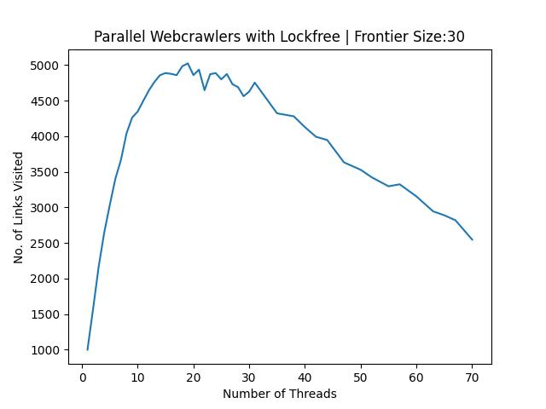
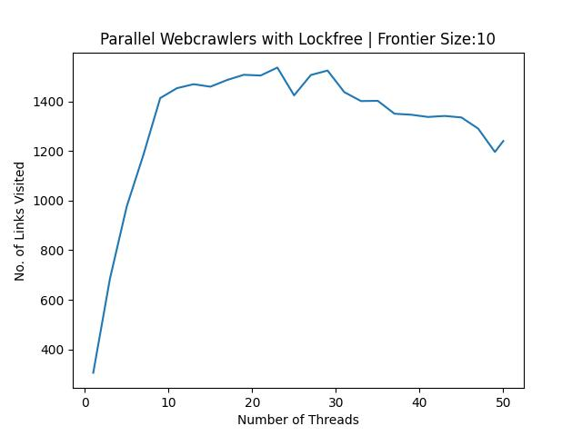
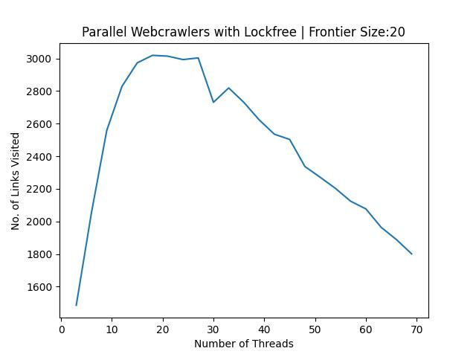
Performance of Lock-free Web crawlers
School or Department, Arial 14 pt.

Slide 35
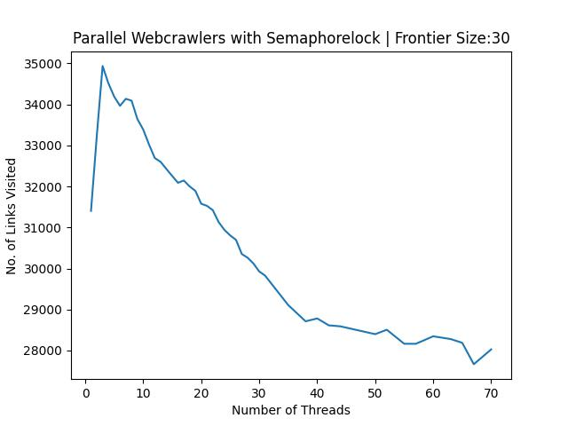
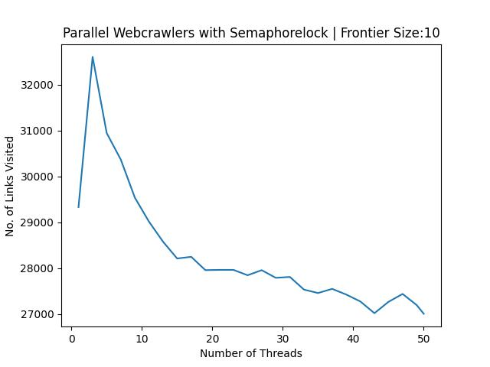
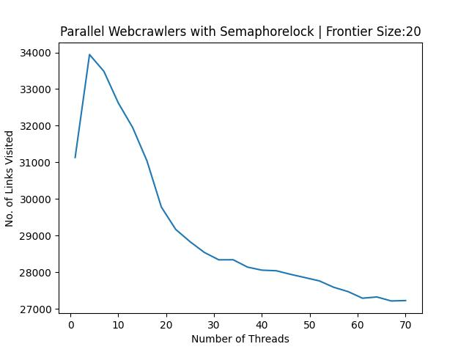
Performance of Web crawlers with semaphore locks
School or Department, Arial 14 pt.

Slide 36
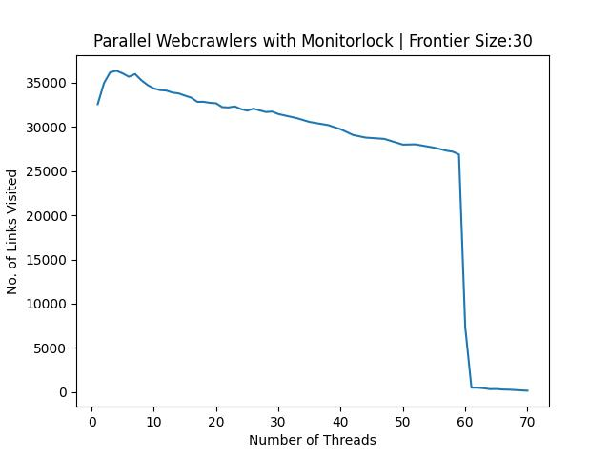
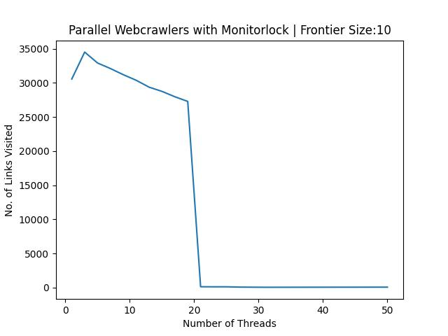
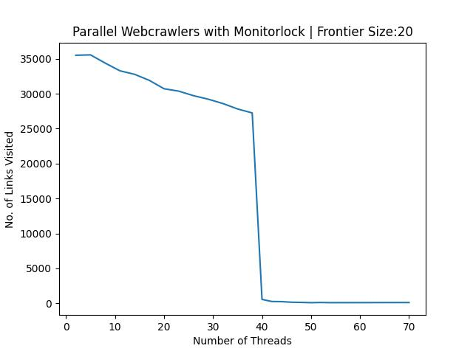
Performance of Web crawlers with Monitor synchronization
School or Department, Arial 14 pt.

Slide 37
Conclusions

Slide 38
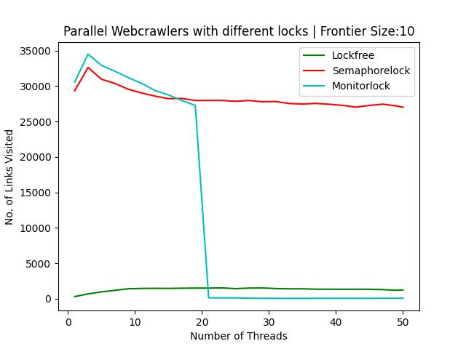
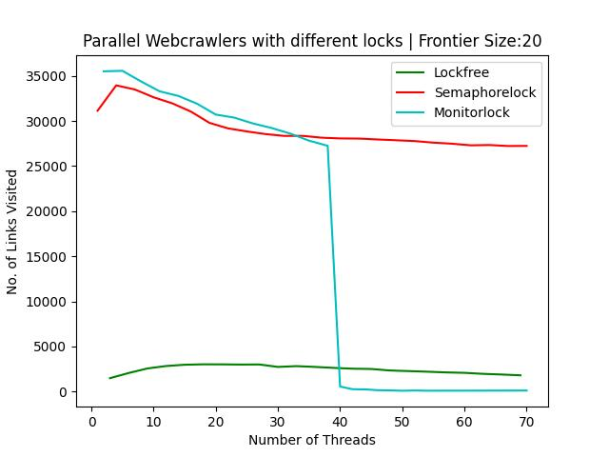
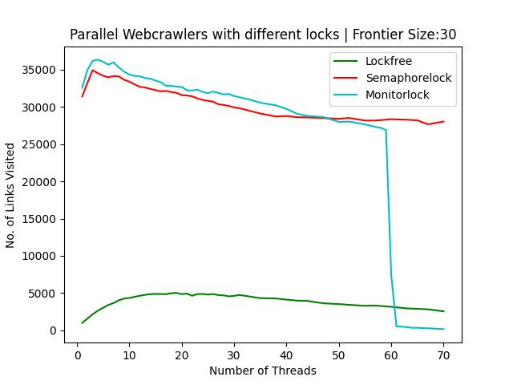
Performance comparison of Web crawlers with different synchronization techniques
Multiple crawlers work better than a single crawler does.
More threads ≠ better efficiency.
number of physical cores (Amdahl’s law)
context switch
Lock-free is the least efficient.
collision inside the critical section
School or Department, Arial 14 pt.

Slide 39
Questions????
Team: Tri-threads
Divya Mahajan | Shruthi Ramprasad | Xi Liu

Slide 40
References

Slide 41
References
[1] Dhar, T., Mazumder, S., Dhar, S., Karak, S., & Chatterjee, D. (2021, October). An Approach to Design and Implement Parallel Web Crawler. In 2021 International Conference on Smart Generation Computing, Communication and Networking (SMART GENCON) (pp. 1-4). IEEE.
[2] Perisetla, K. K. (2012). Mutual exclusion principle for multithreaded web crawlers. Edit Preface, 3(9).
[3] Sultanov, A., Protsyk, M., Kuzyshyn, M., Omelkina, D., Shevchuk, V., & Farenyuk, O. (2021, September). Comparison of performance of the popular approaches to implementing parallel crawlers. In 2021 IEEE 16th International Conference on Computer Sciences and Information Technologies (CSIT) (Vol. 1, pp. 349-352). IEEE.
[4] Liu, H., Hu, T., & Qiu, Z. (2017, September). Automatic fine-grained locking generation for shared data structures. In 2017 International Symposium on Theoretical Aspects of Software Engineering (TASE) (pp. 1-8). IEEE.
[5] Meegahapola, L., Alwis, R., Heshan, E., Mallawaarachchi, V., Meedeniya, D., & Jayarathna, S. (2017, August). Adaptive technique for web page change detection using multi-threaded crawlers. In 2017 Seventh International Conference on Innovative Computing Technology (INTECH) (pp. 120-125). IEEE.
[6] Wang, H., Wang, Z., Sun, J., Liu, S., Sadiq, A., & Li, Y. F. (2020, September). Towards generating thread-safe classes automatically. In 2020 35th IEEE/ACM International Conference on Automated Software Engineering (ASE) (pp. 943-955). IEEE.
[7] Tanenbaum, A. (2009). Modern operating systems. Pearson Education, Inc.,
[8] Multithreaded crawler in Python. GeeksforGeeks. (2021, September 23). Retrieved May 12, 2022, from https://www.geeksforgeeks.org/multithreaded-crawler-in-python/
[9] Optimistic algorithm. (n.d.). Retrieved May 18, 2022, from https://courses.cs.vt.edu/~cs5204/fall99/distributedSys/optimistic.html#:~:text=Optimistic%20Concurrency%20Control%20Algorithms%20are,that%20no%20conflicts%20have%20occured.
[10] Herlihy, M., & Shavit, N. (2008). The Art of Multiprocessor Programming [SMP].
[11] Hill, M. D., & Marty, M. R. (2008). Amdahl's law in the multicore era. Computer, 41(7), 33-38.
[12] “Optimistic Concurrency Control.” Wikipedia, Wikimedia Foundation, 19 Apr. 2022, https://en.wikipedia.org/wiki/Optimistic_concurrency_control.
[13] 11, Emnuel May, et al. “Optimistic vs. Pessimistic Locking.” Vlad Mihalcea, 16 Feb. 2022, https://vladmihalcea.com/optimistic-vs-pessimistic-locking/.
[14] “Record Locking.” Wikipedia, Wikimedia Foundation, 23 Oct. 2021, https://en.wikipedia.org/wiki/Record_locking.
[15] Coarse-Grained and Fine-Grained Locking - Lunds Tekniska Högskola. https://fileadmin.cs.lth.se/cs/Education/EDA015F/2013/Herlihy4-5-presentation.pdf.
[16] Coarse-Grained, Fine-Grained, and Lock-Free ... - UNLV Libraries. https://digitalscholarship.unlv.edu/cgi/viewcontent.cgi?article=4733&context=thesesdissertations.
[17] Optimistic Algorithm, https://courses.cs.vt.edu/~cs5204/fall99/distributedSys/optimistic.html#:~:text=Optimistic%20Concurrency%20Control%20Algorithms%20are,that%20no%20conflicts%20have%20occured.
[18] “Difference between Pessimistic Approach and Optimistic Approach in DBMS.” GeeksforGeeks, 29 June 2021, https://www.geeksforgeeks.org/difference-between-pessimistic-approach-and-optimistic-approach-in-dbms/.
COEN- 283 Operating Systems

Slide 42
Thank You
Team: Tri-threads
Divya Mahajan | Shruthi Ramprasad | Xi Liu

